Slide 1
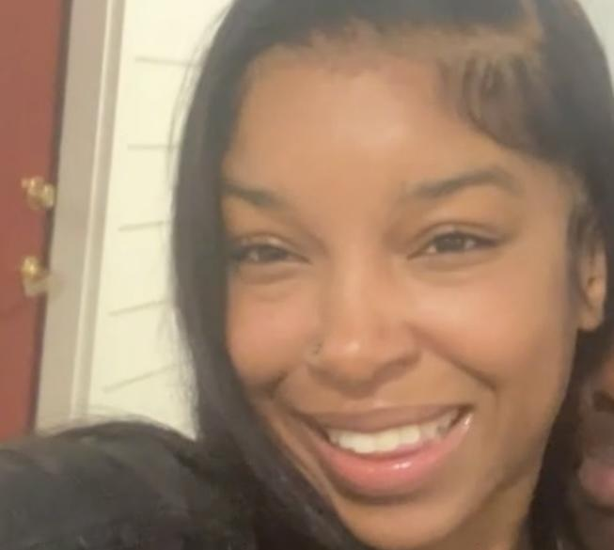
All About Me
Student Profile
Kristen Ransom

Slide 2
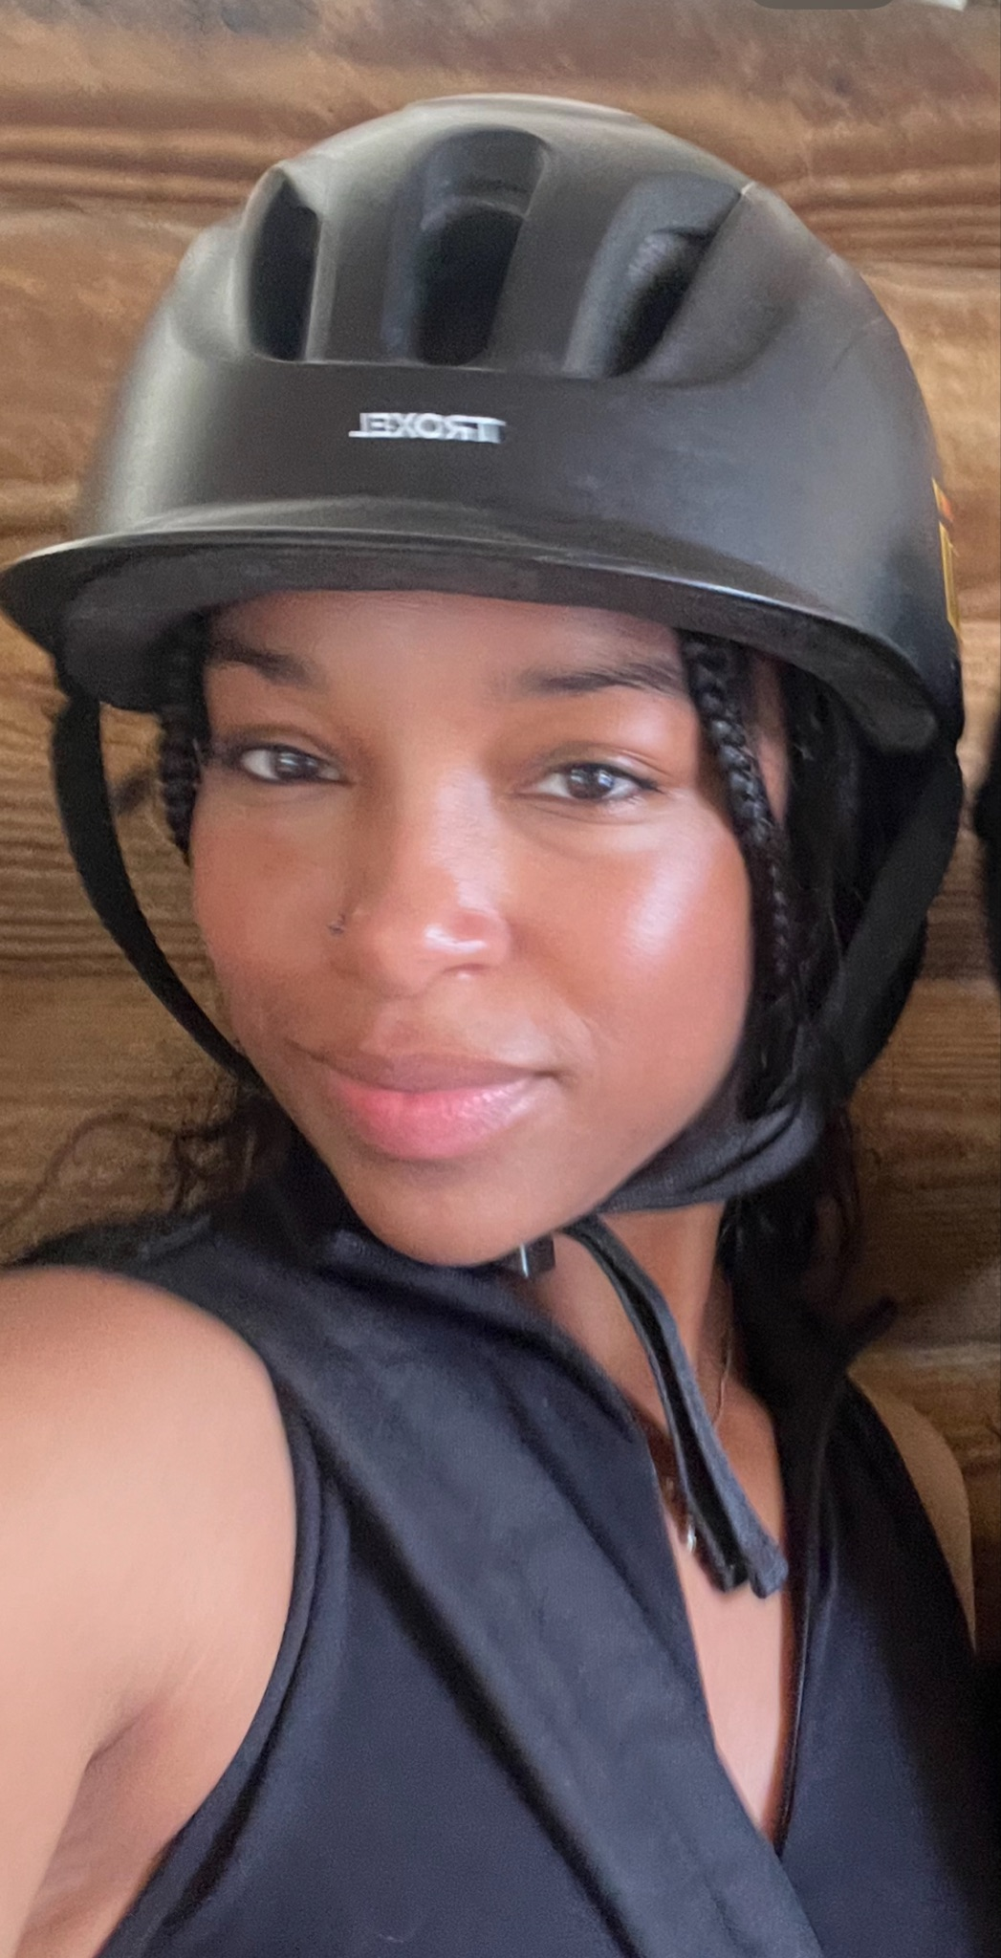
Introduction
My name is Kristen Ransom! I’m a Sophomore majoring in Secondary Education for English and History. I originally started my college career at Hampton University, but transferred to Towson last spring semester. I’ve always had an interest in Education, but was once interested in Biology and Psychology.

Slide 3
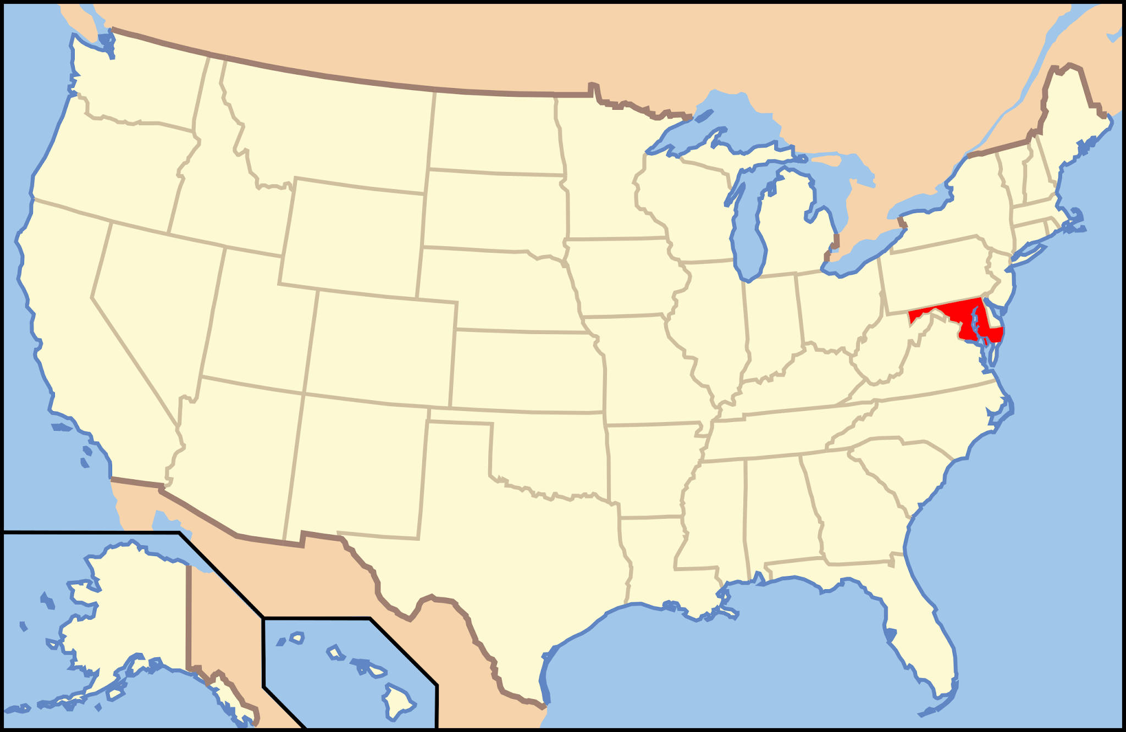
My Home
I’ve grown up in the Maryland area my whole life. I attended Elementary, Middle, and High School in Prince George’s County in the Laurel/College Park area as well.
Going to Hampton University in Hampton, Virginia was my first time living away from home and independently, but ultimately I decided that Maryland feels most like home.

Slide 4
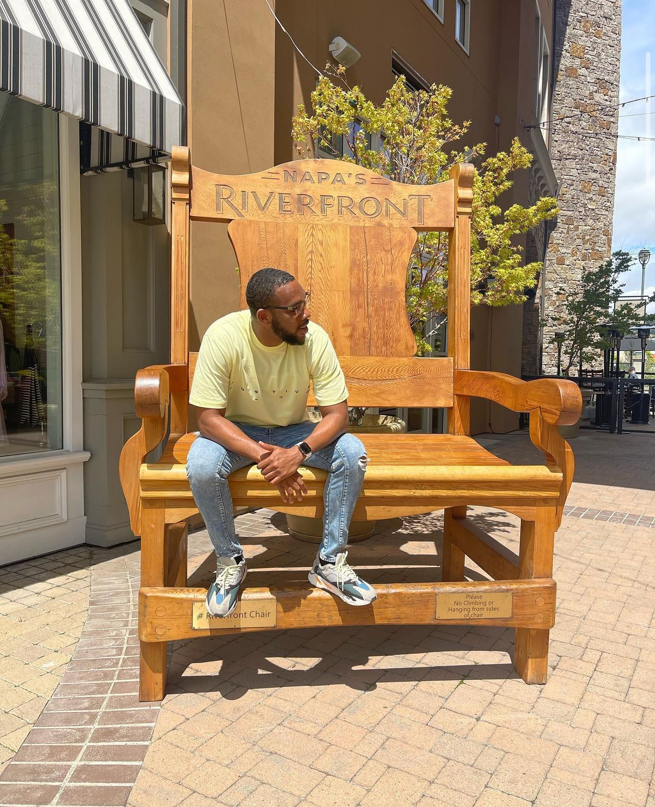
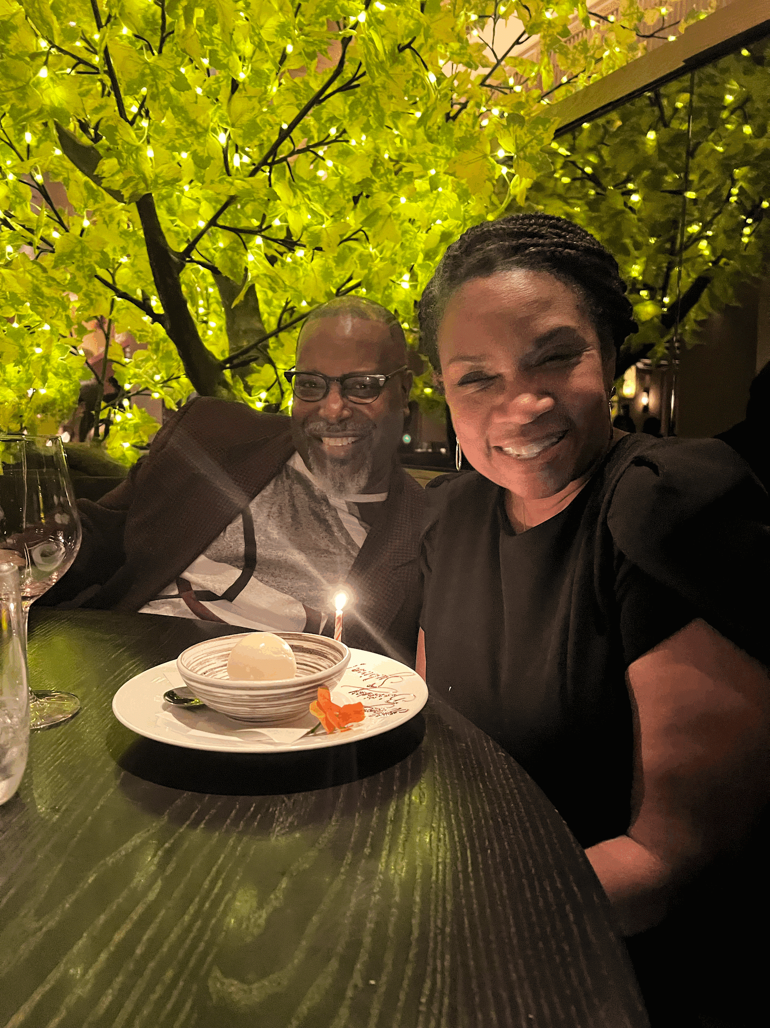
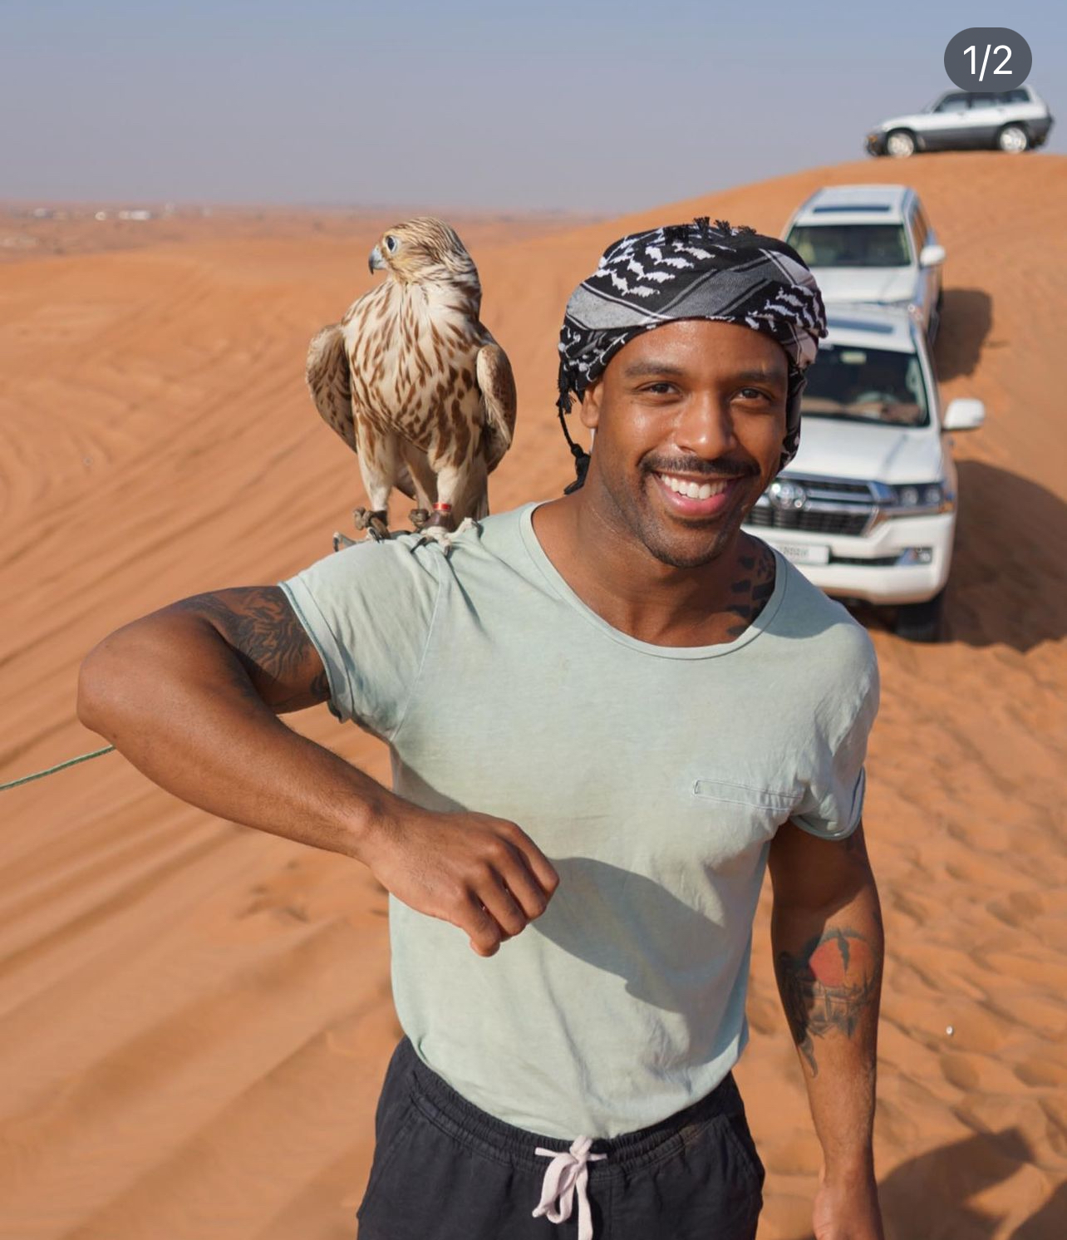
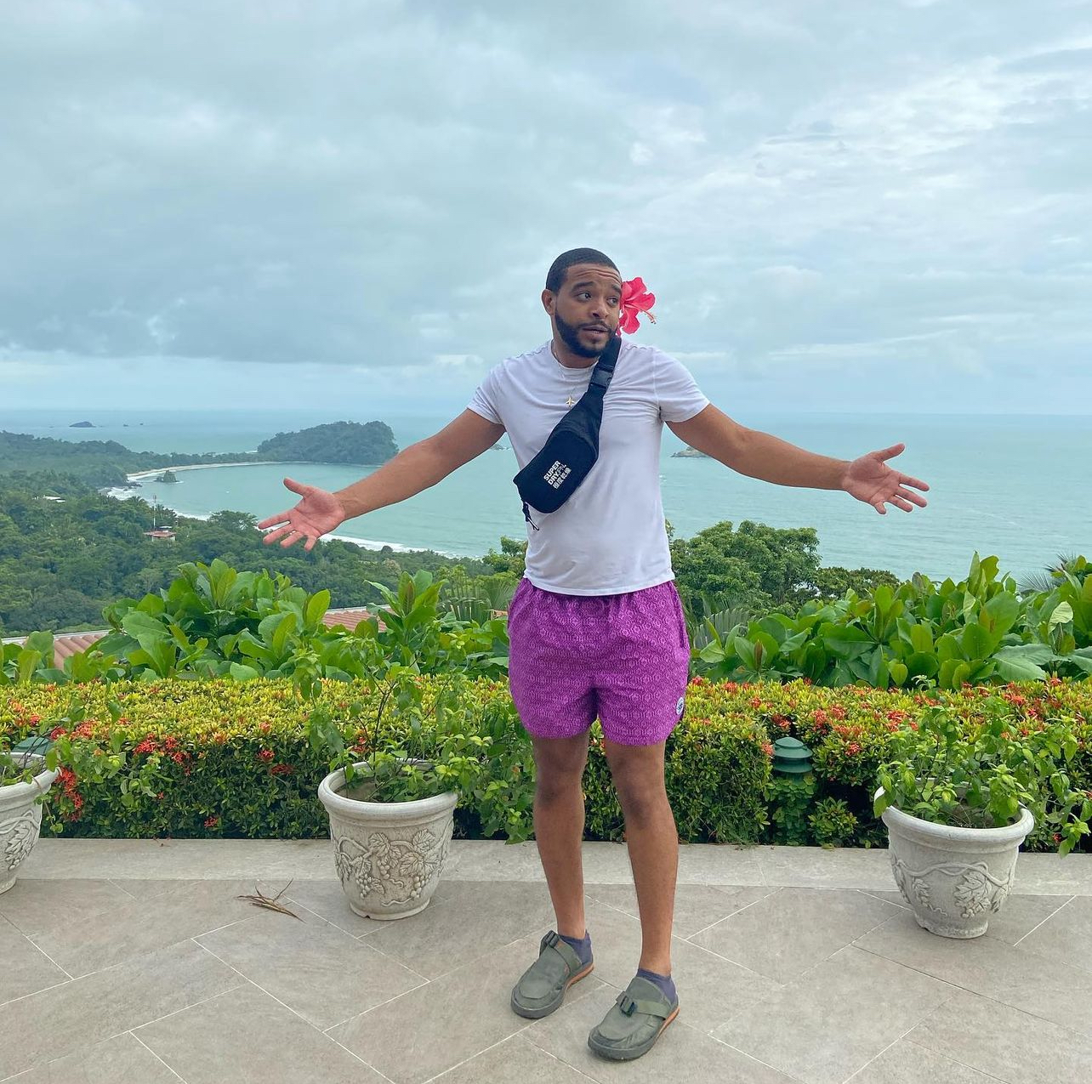
My Family
I grew up with my Mother, Father, and 3 older brothers, making me the youngest and only girl! Most of my family lives on the East Coast in MD, NY, GA, NC, PA, and others.

Slide 5
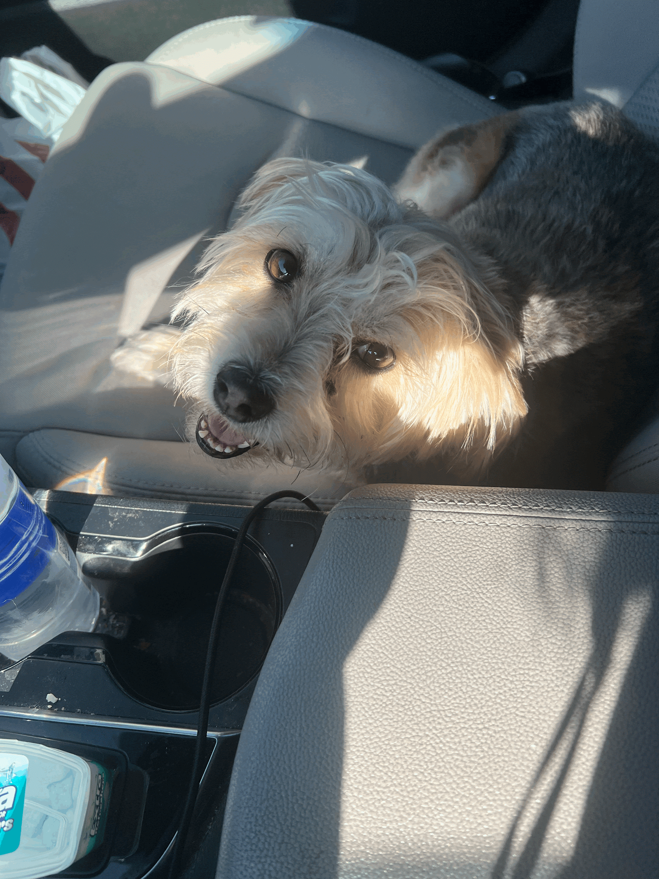
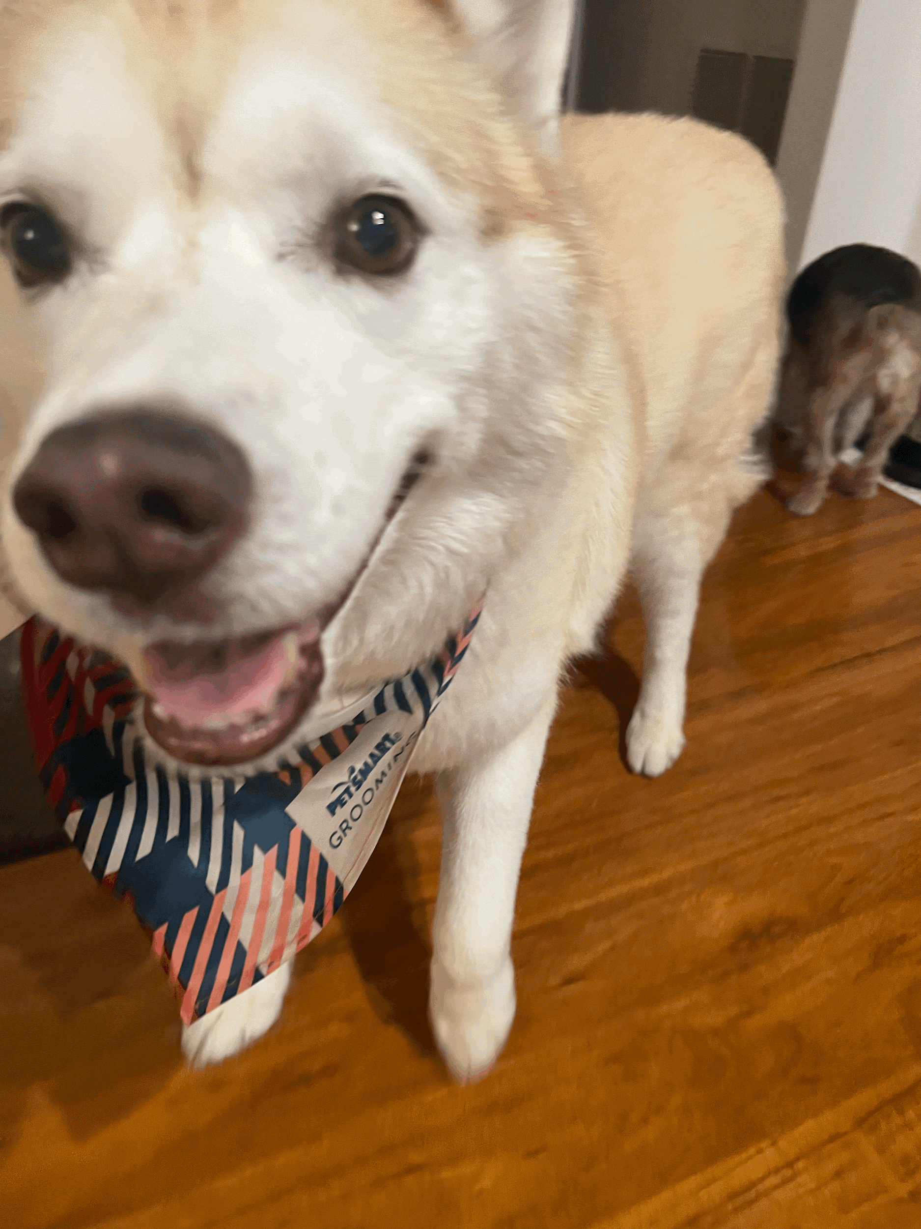
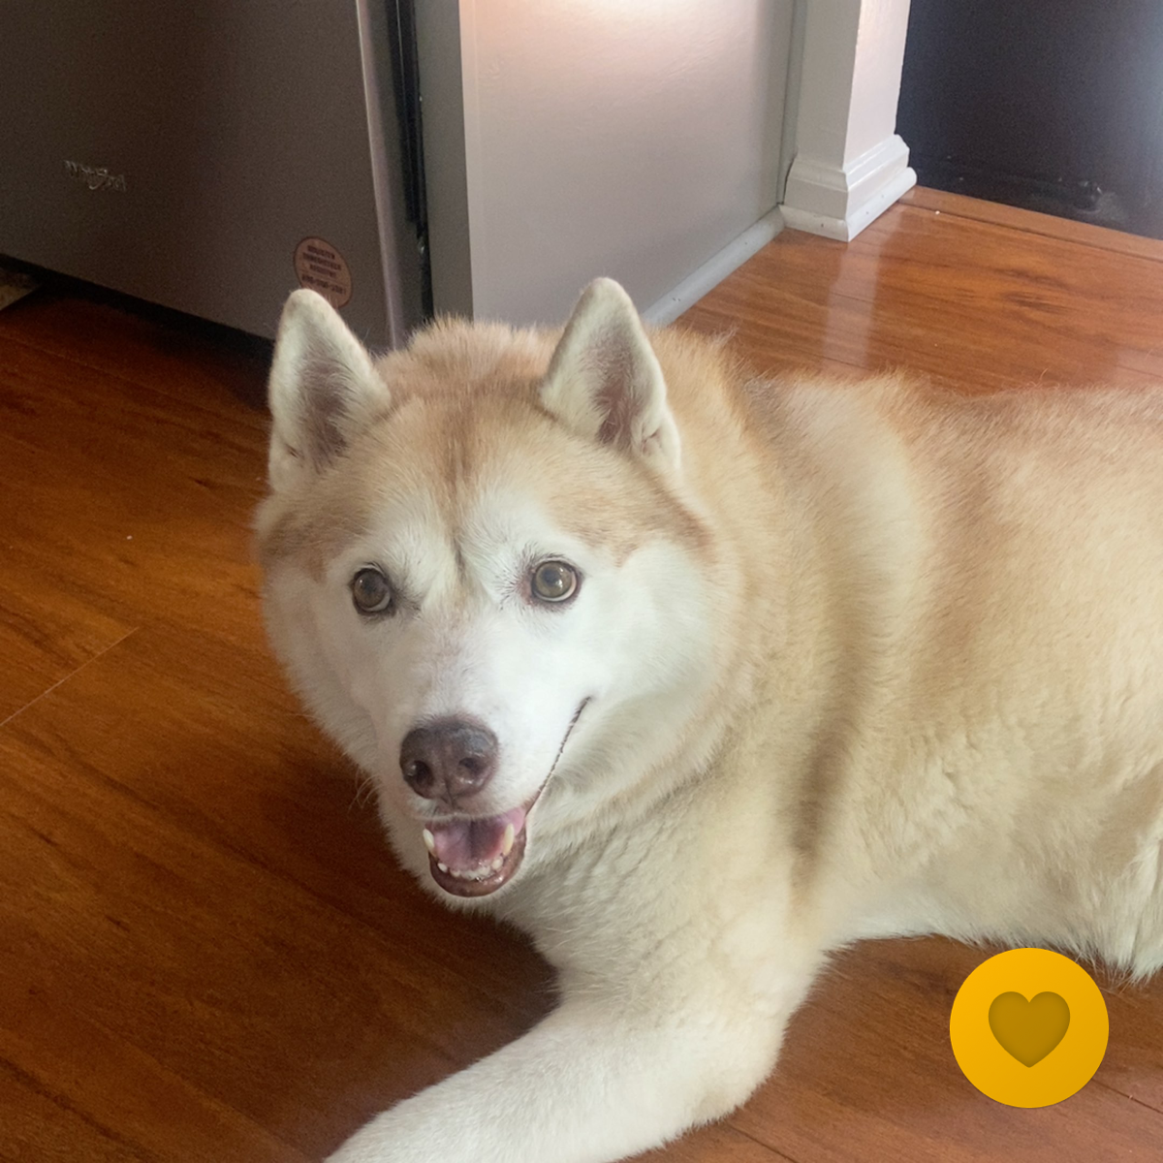
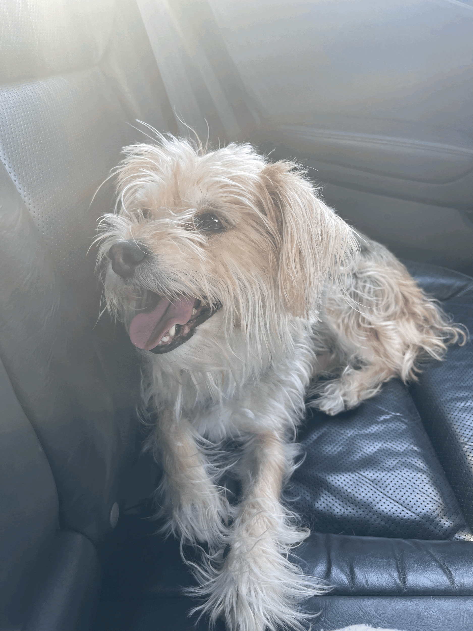
Pets
I have 2 dogs. A 12 year old Siberian Husky named Aurora and a 10 year old Morkie (Maltese and Yorkie) named Daisy. I also have several fish of various species. I love all pets and wish to have another dog or a kitten soon to have as my own!

Slide 6



Schooling
Laurel High School
Hampton University
Towson University
I went to Laurel High School for 9-12th Grade and participated in the IB Program. I was able to do various clubs and manage Girl’s Lacrosse and Soccer.
I went to Hampton University for my freshman year of college and explored the different activities and opportunities an HBCU offers.
I’ve been at Towson for a year and commute from the PG area. I haven’t had the chance to look into activities on campus, but am looking forward to this semester.

Slide 7
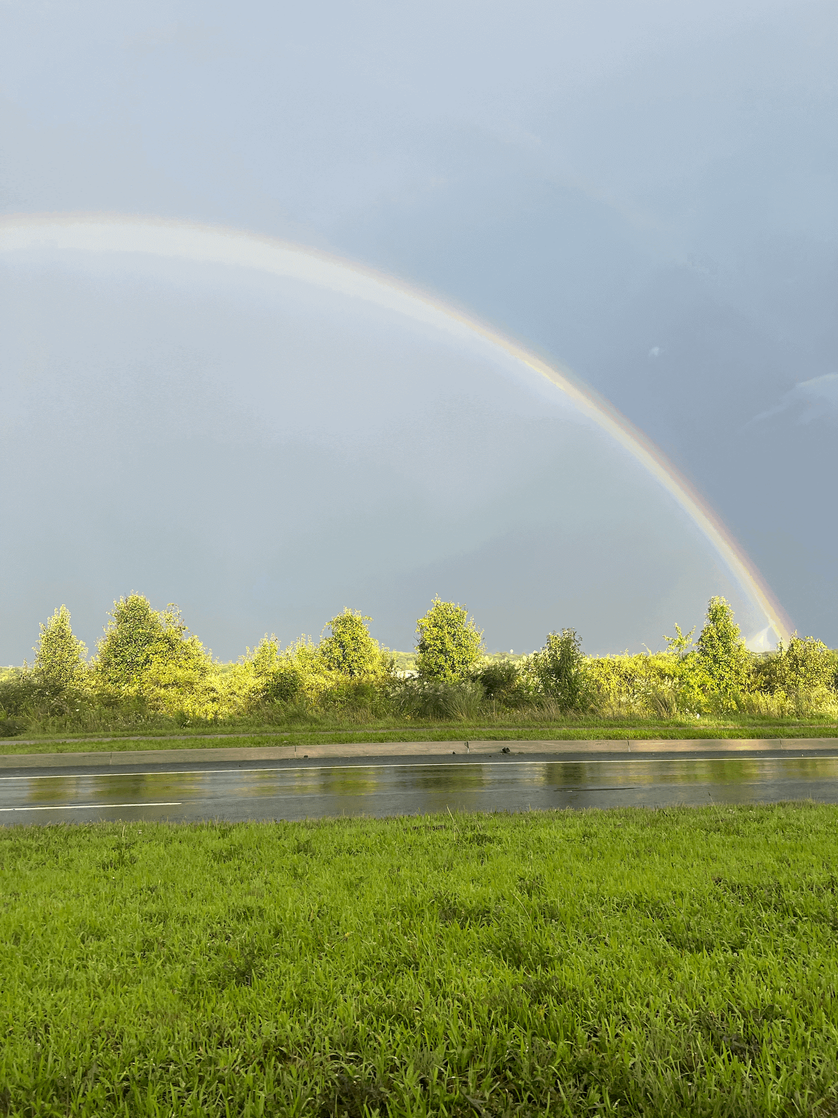
My Major
Pre-College
Education
I originally was accepted to school for Biology, but chose to pursue Education which has always been a passion of mine.
I wanted to teach because of the wish to provide knowledge to others and help where I can.

Slide 8
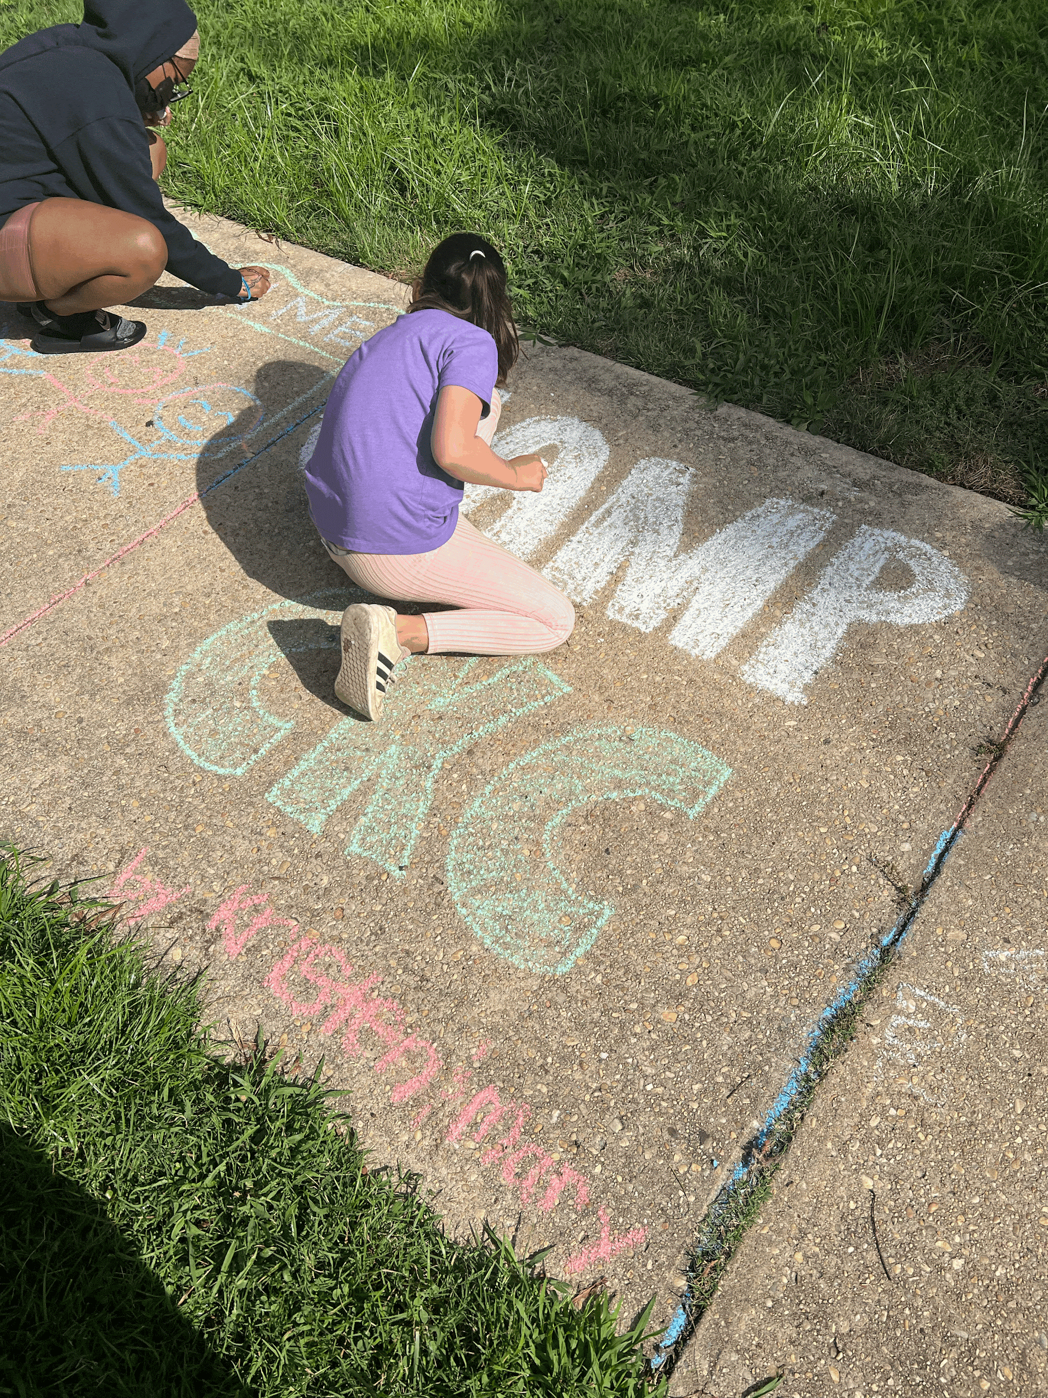
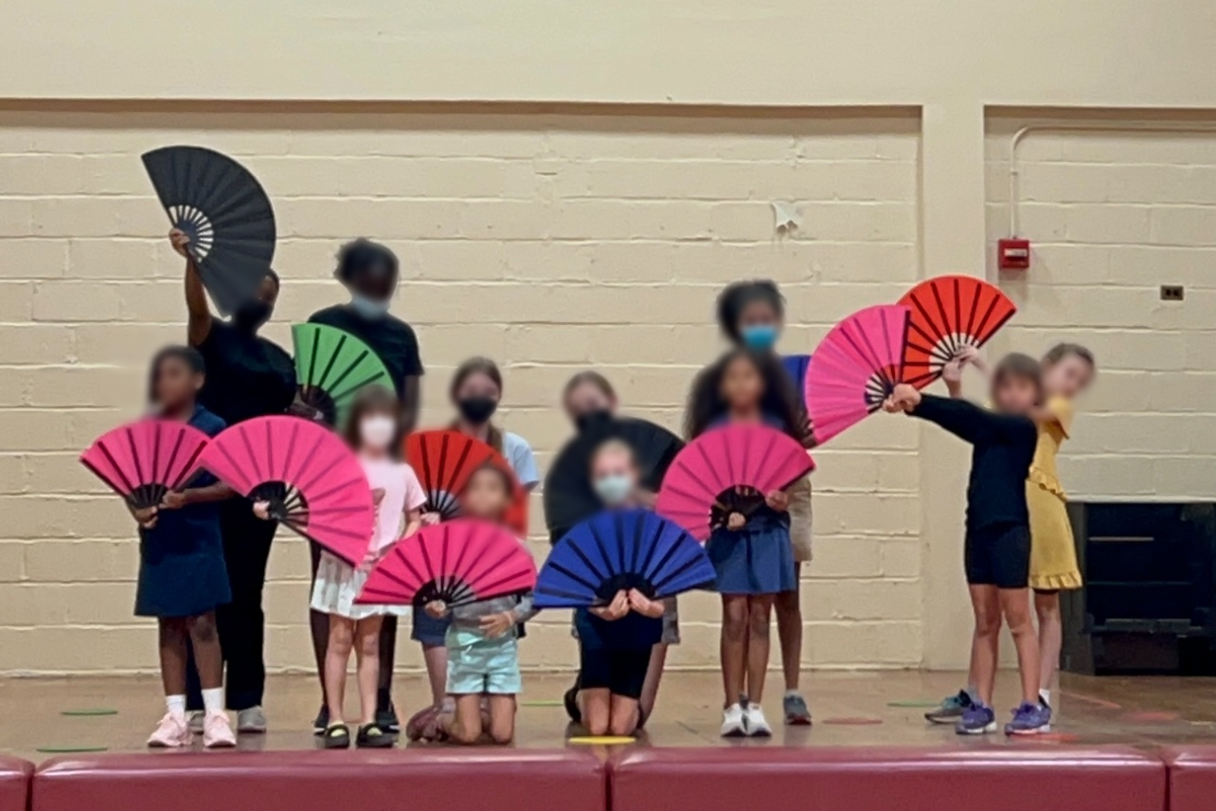
Work Experience
Creative Kids
I worked as a Camp Counselor Summer 2022 and 2023. At this camp, the kids participated in Theater, Art, Dance, and Music.

Slide 9
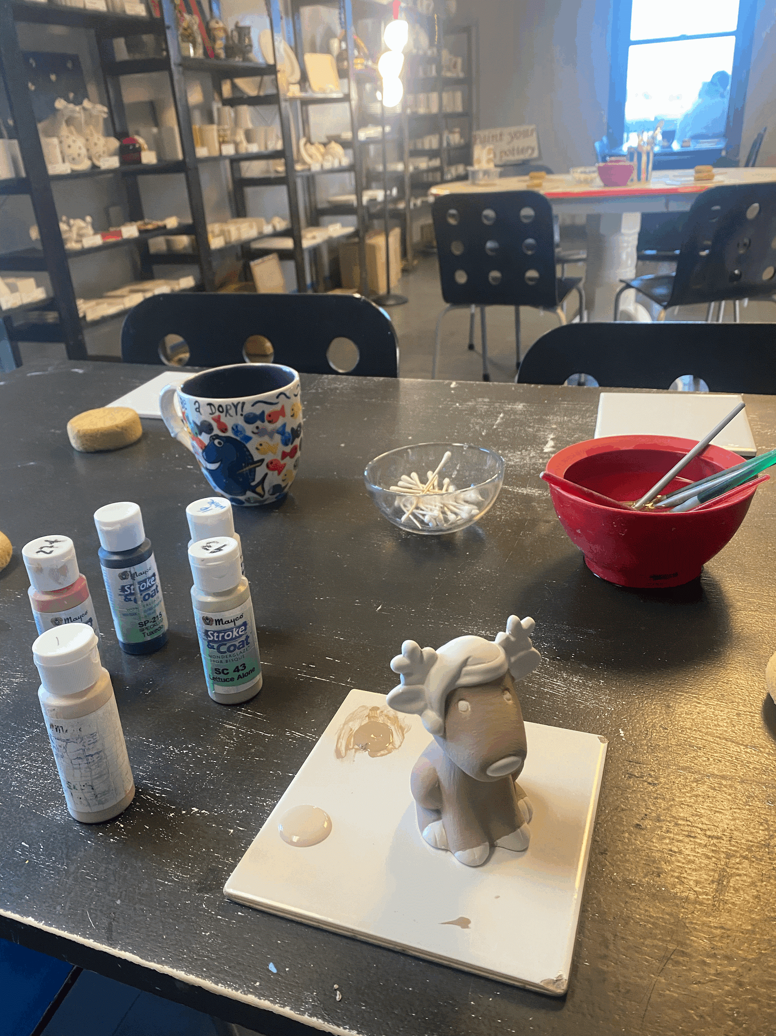
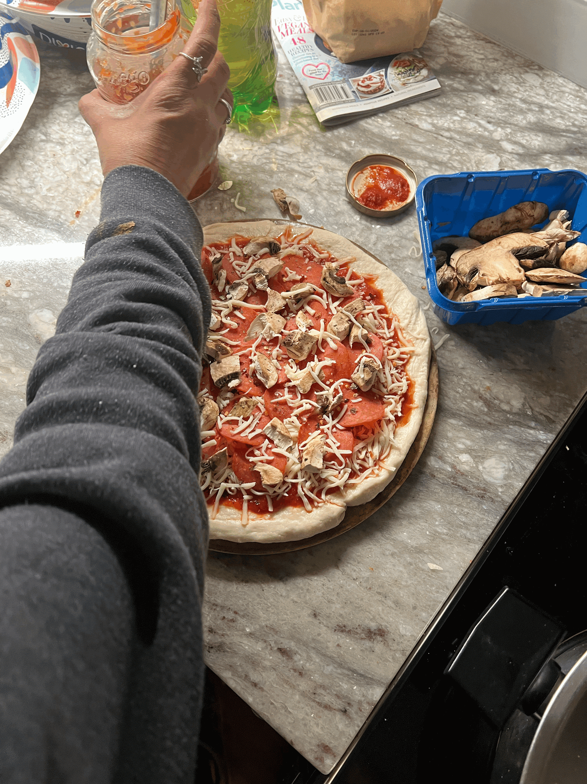
Hobbies
Pottery Painting
Yoga
Cooking

Slide 10
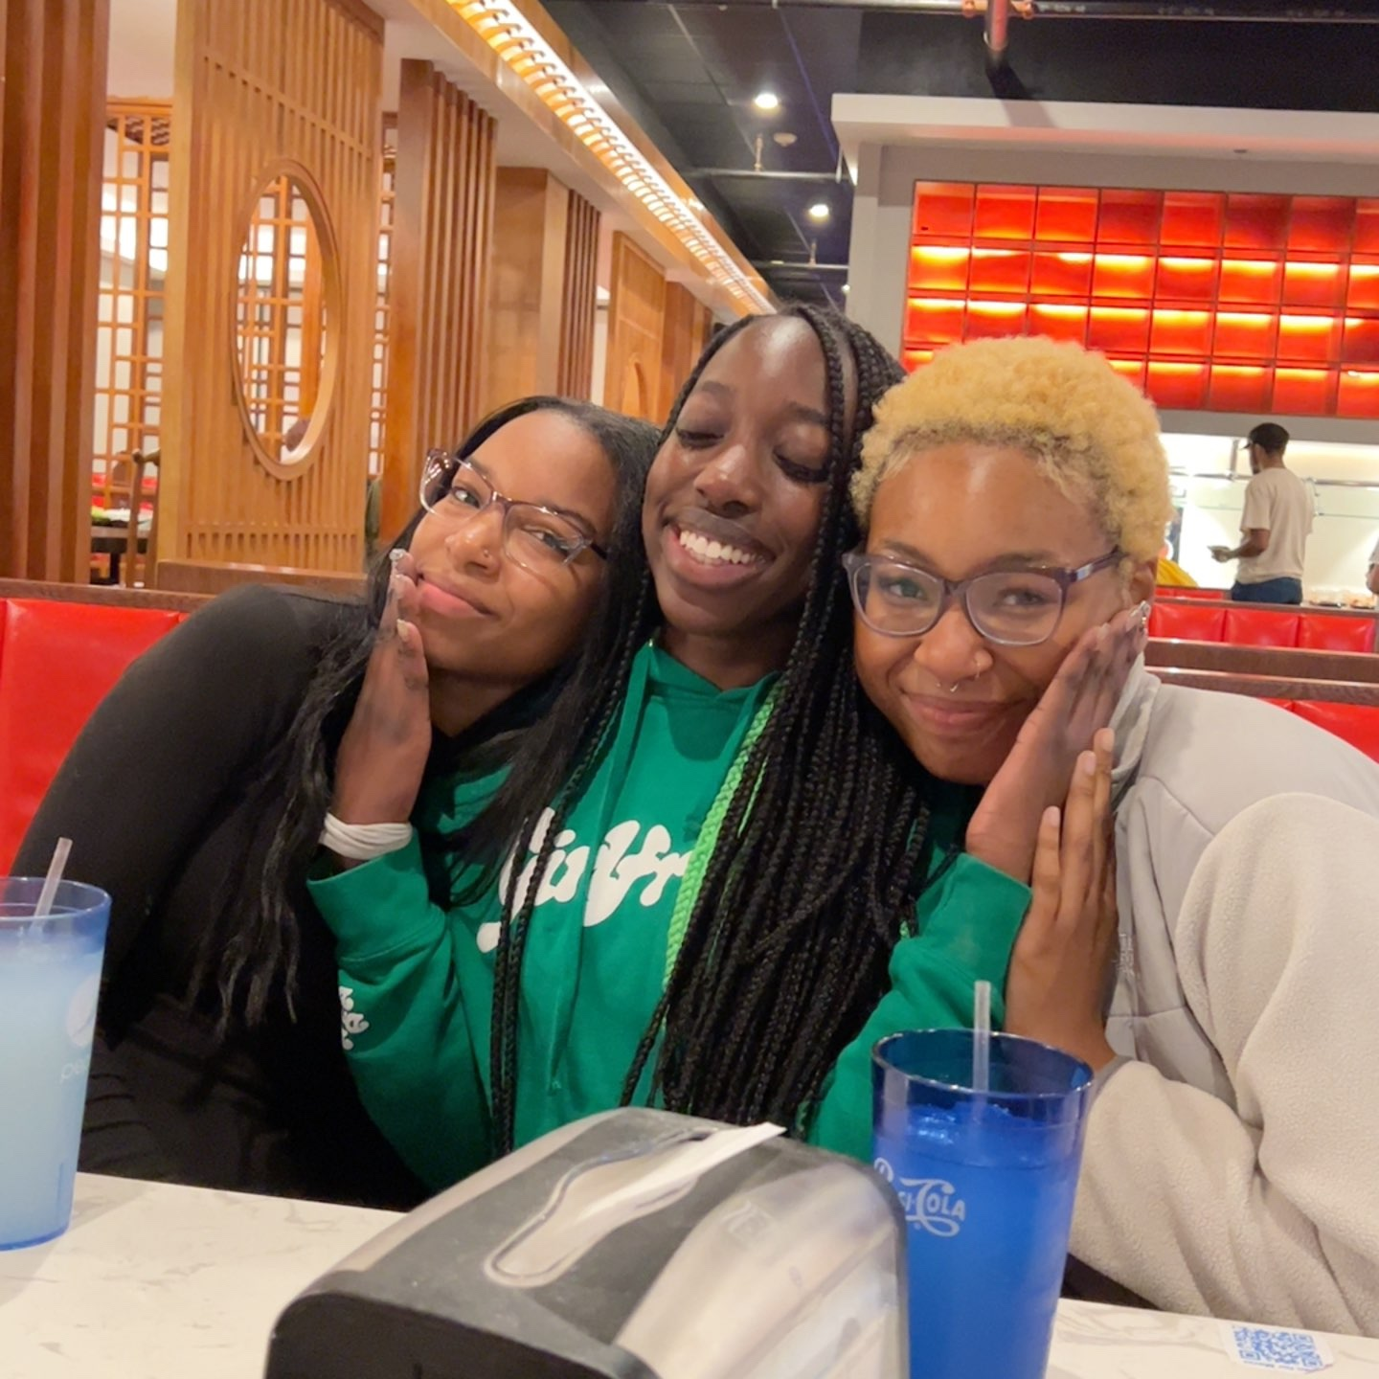
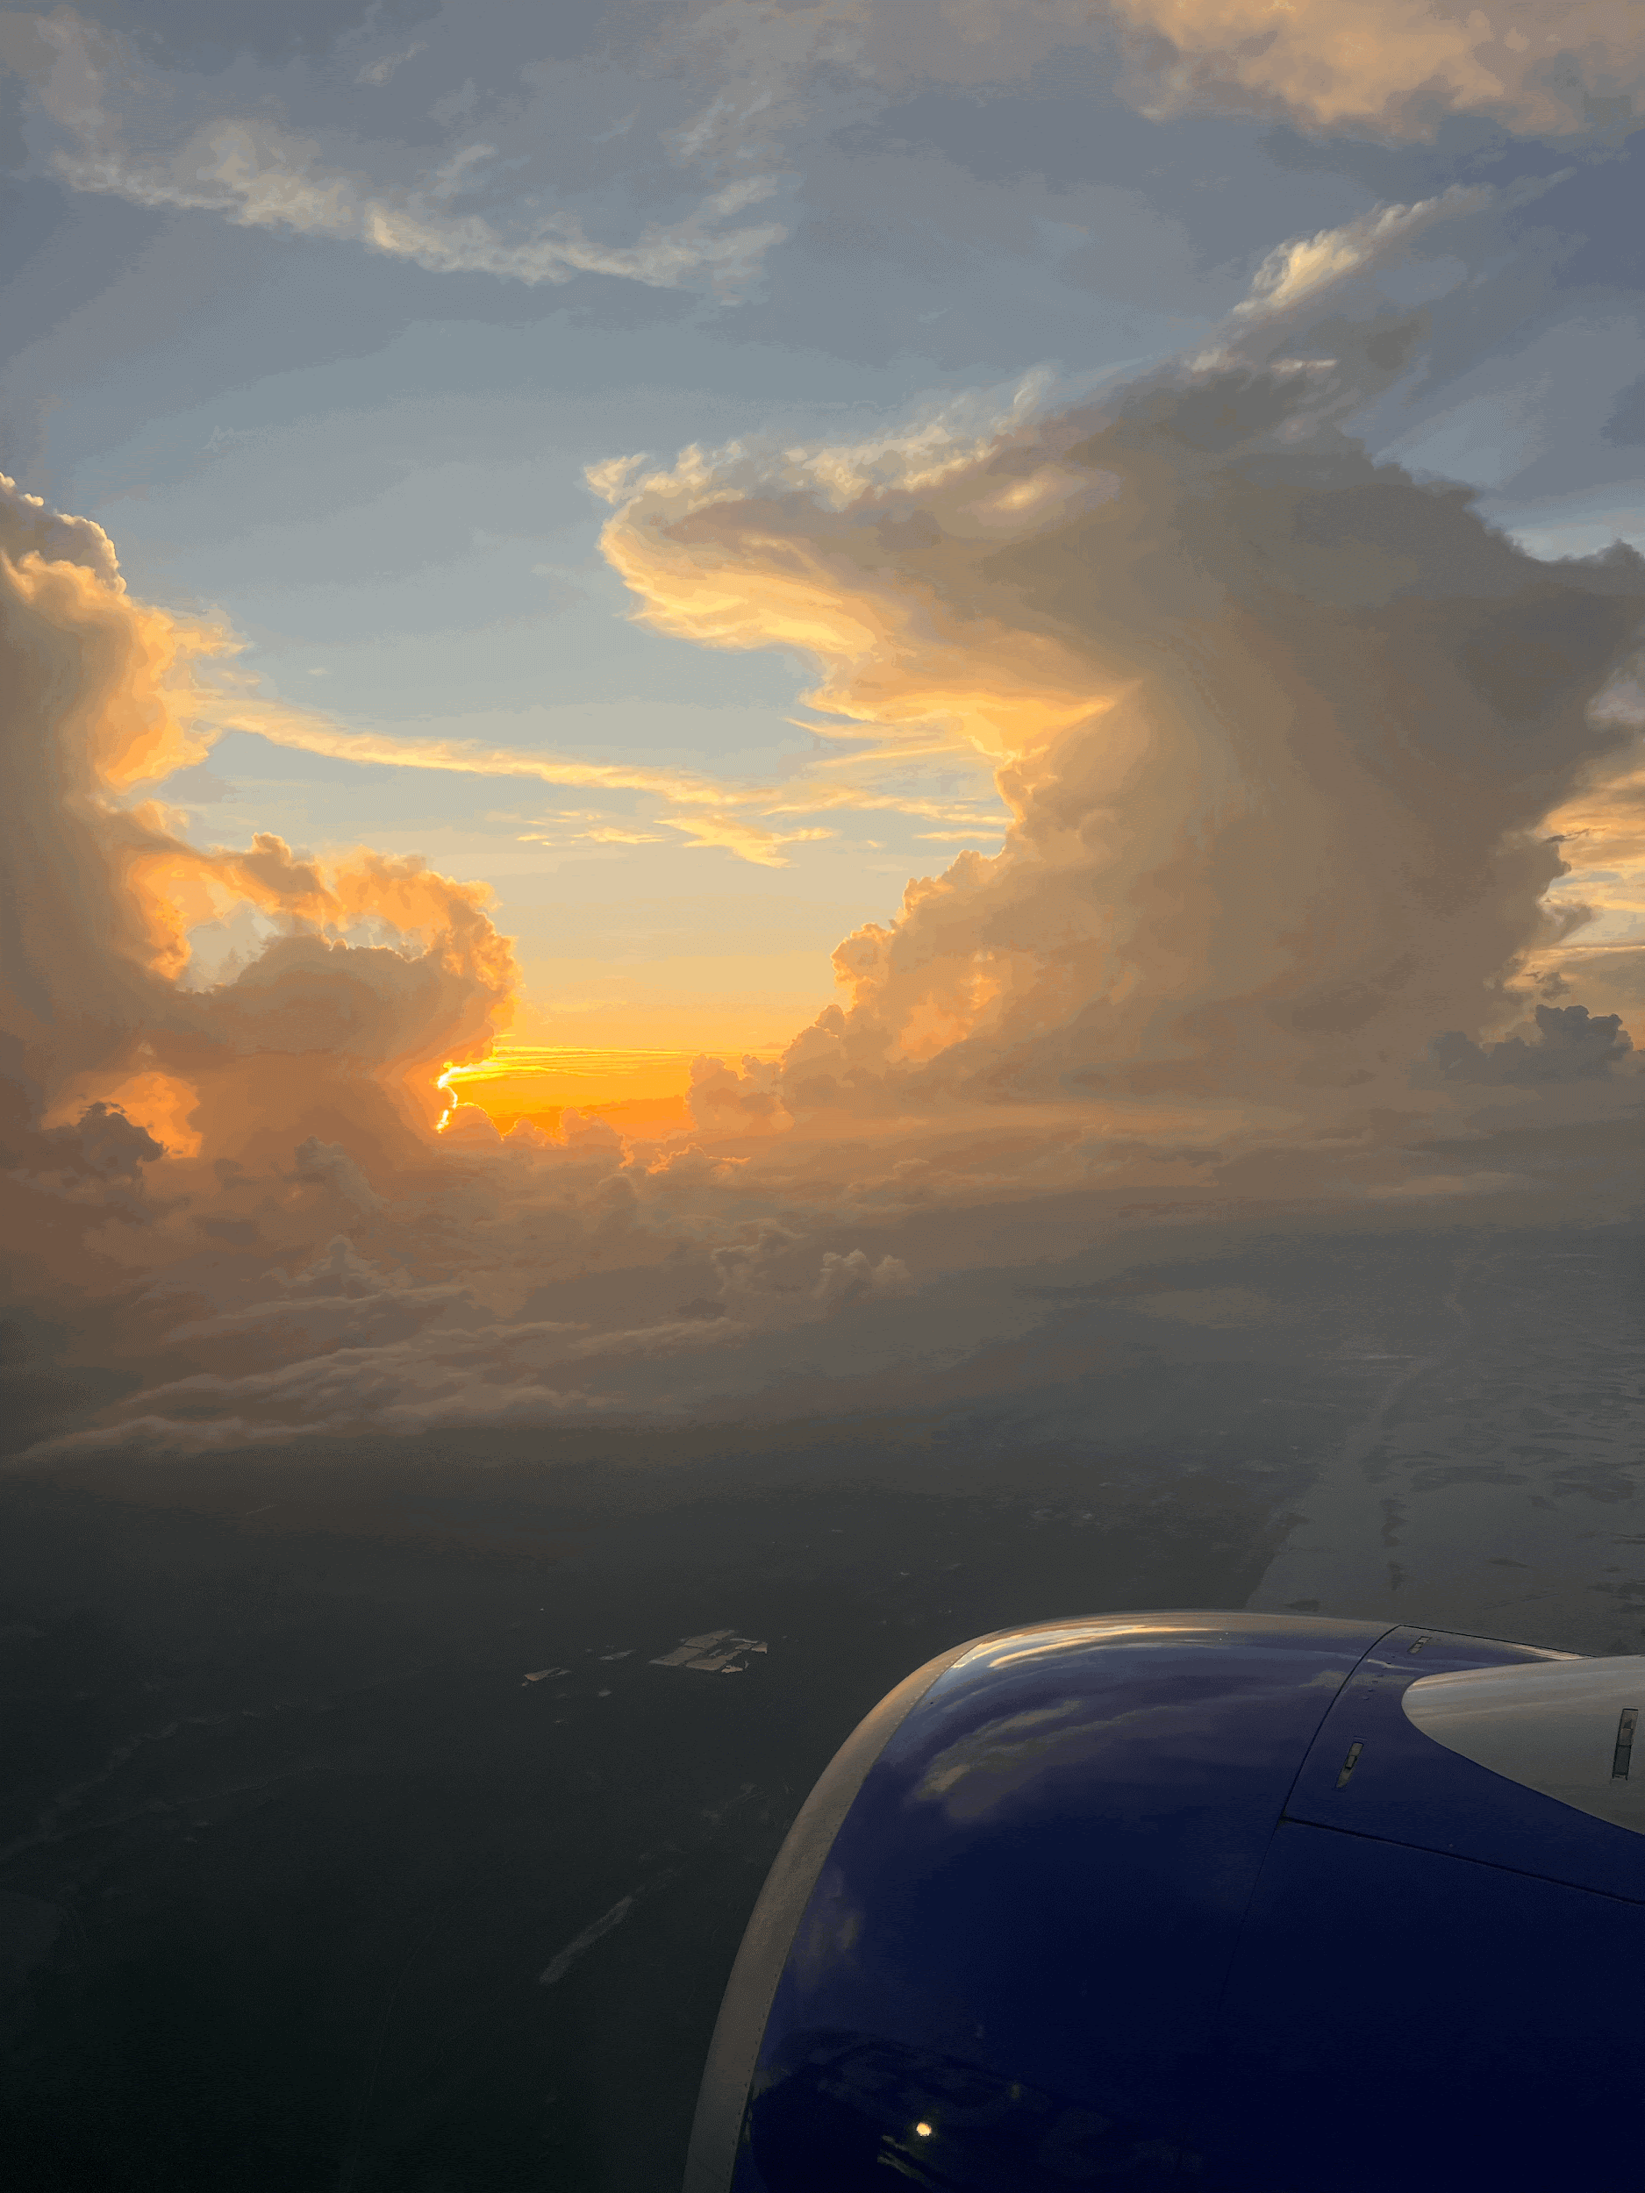
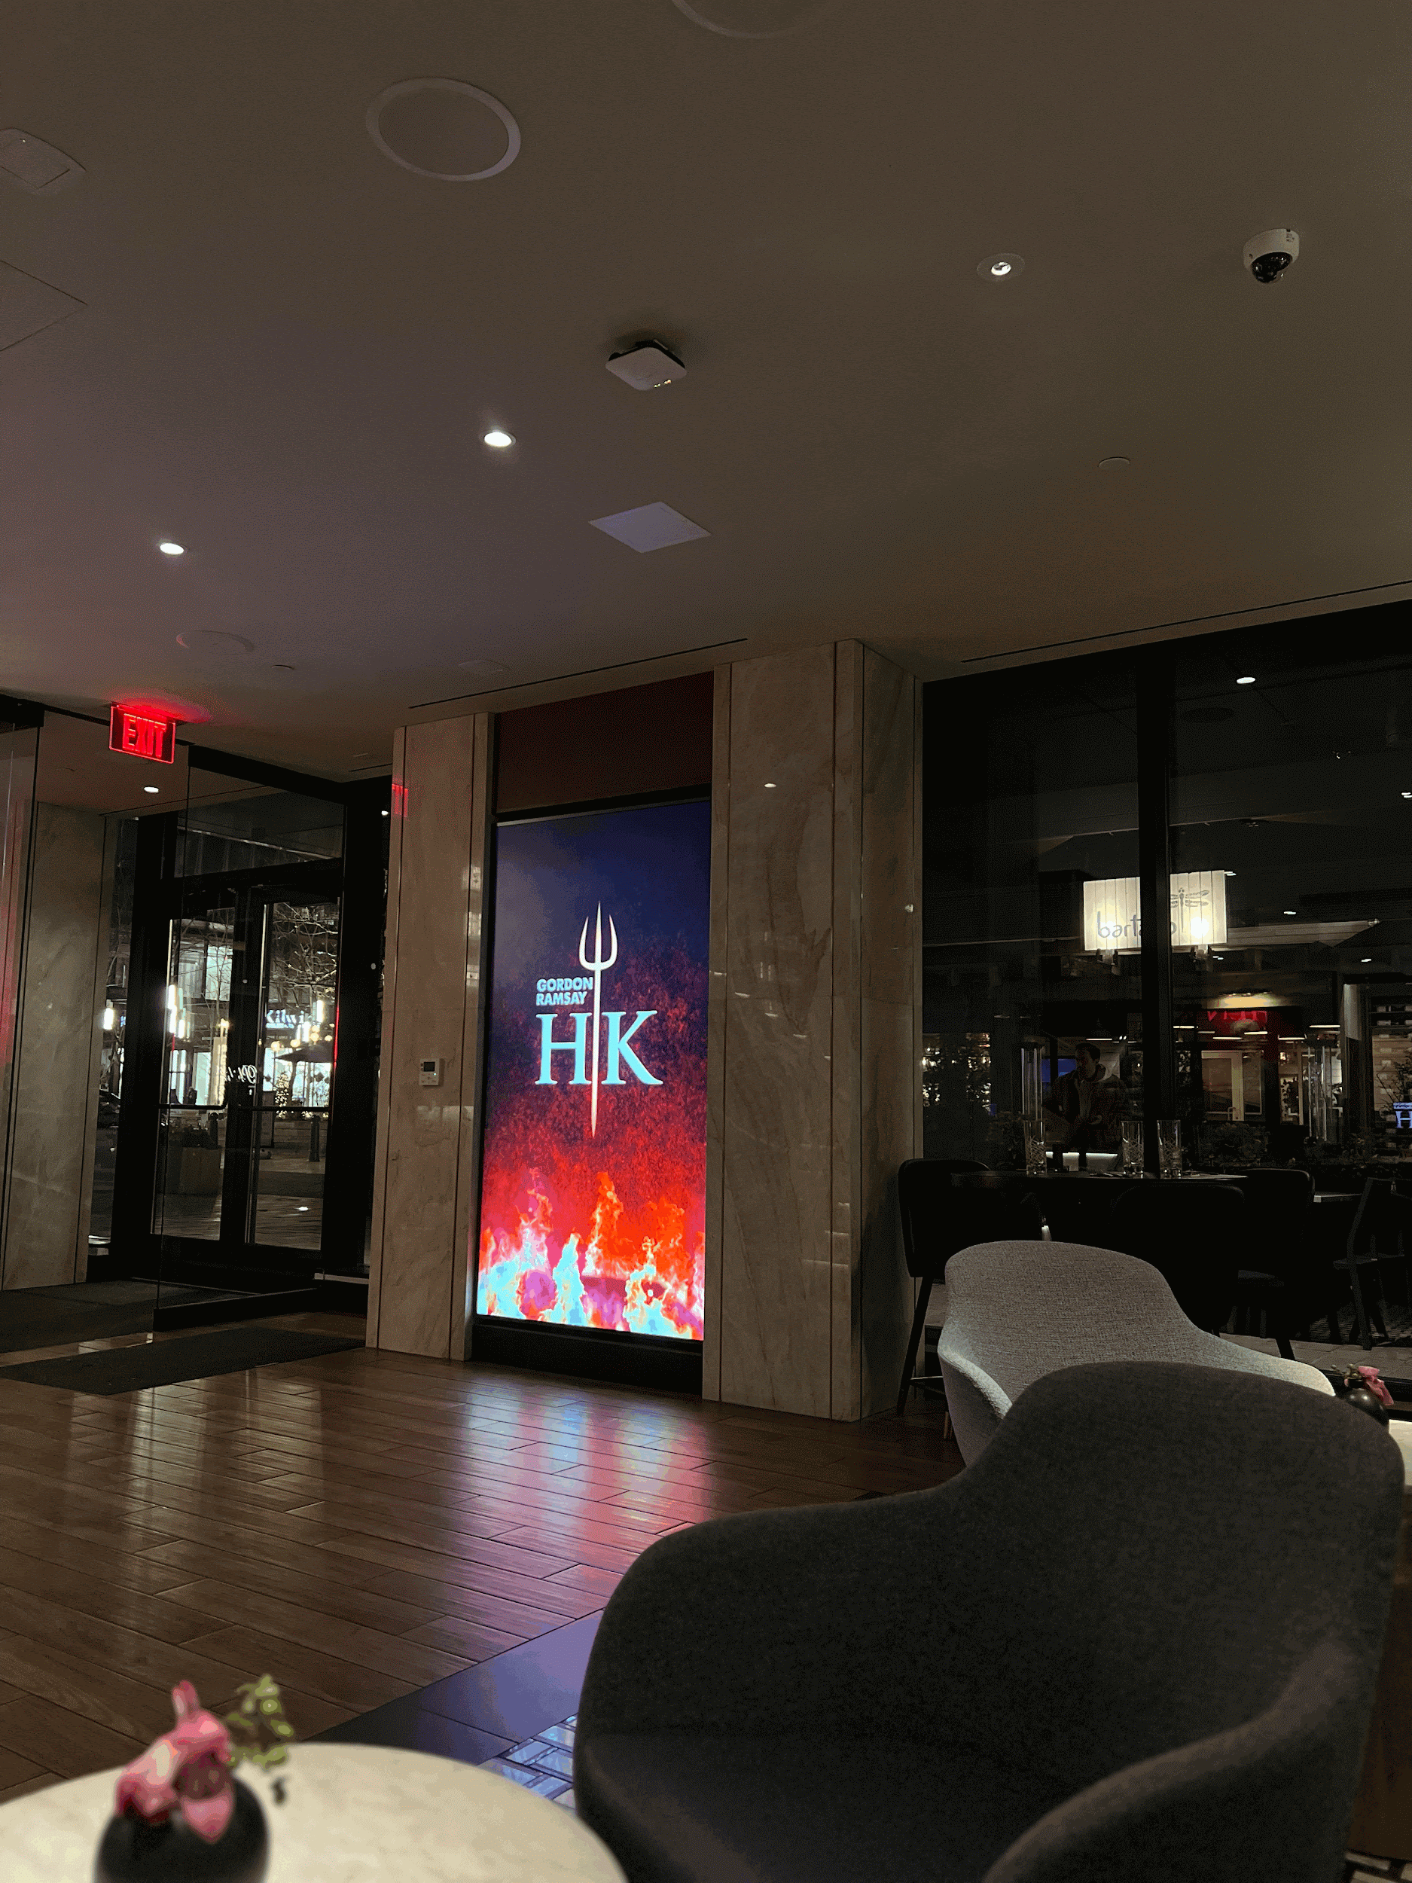
Favorite Things!
Some of my favorite things include:
Spending time with my friends
Trying new restaurants or activities
Traveling with friends and family

Slide 11
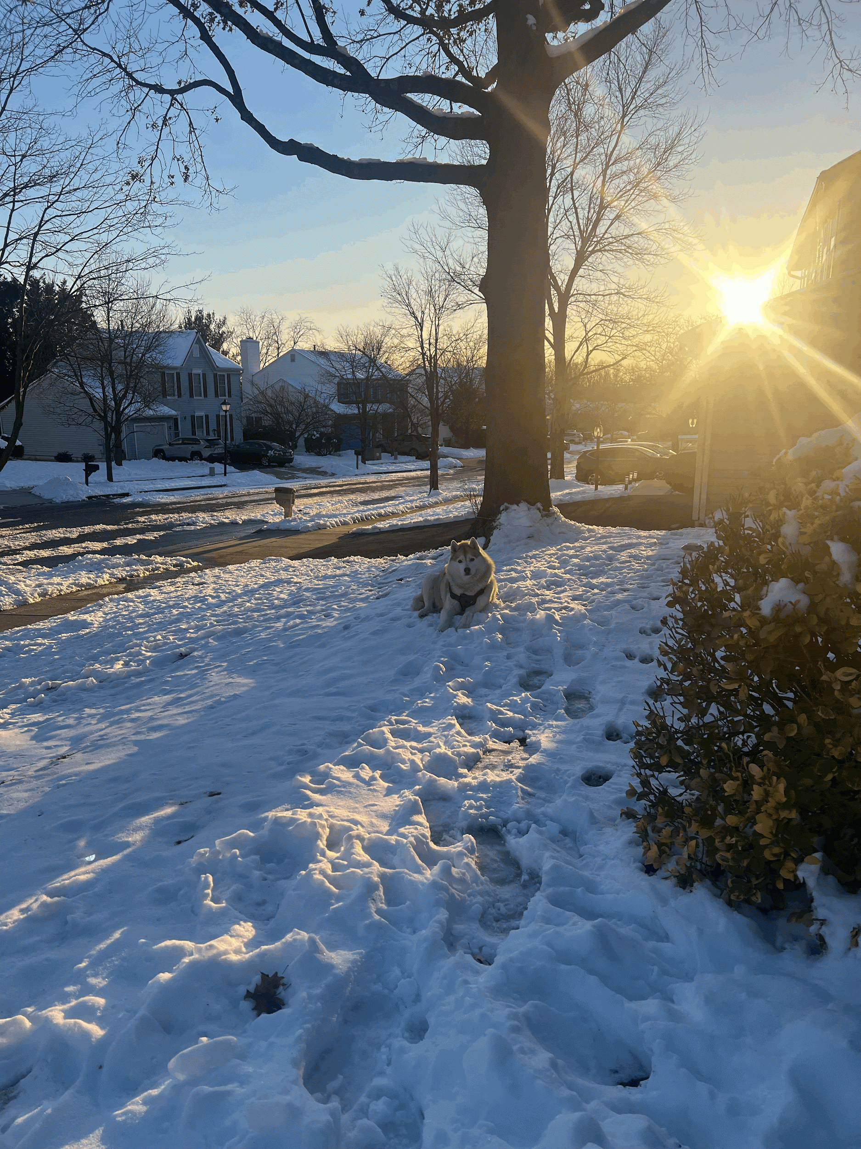
Fun Facts!
My middle name is Jhene after the R&B singer.
I’m the youngest girl in my family.
01
02
03
My Husky is named after Sleeping Beauty.

Slide 12
References
My Camera Roll
Google Images

